Slide 1

Virtual Study Group
Virtual Study Group
H

Slide 2
Group Members
-Cy Miller
-Sara Ram
-Gorkem Varol
-Jacqueline Nguyen
-Helen Akinyele
We set out to create a website that pairs students in need of study partners with others who are studying the same subject at the same level. We do this by having the student fill out a form and then storing the data.
H

Slide 3
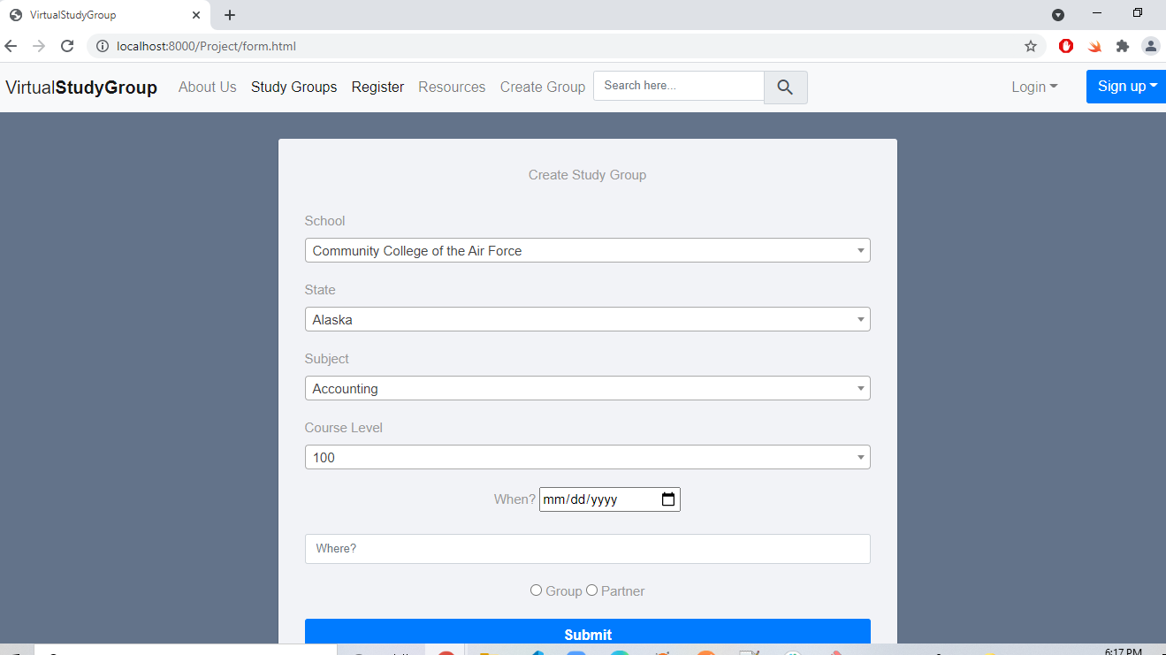
Create Study Group
s

Slide 4
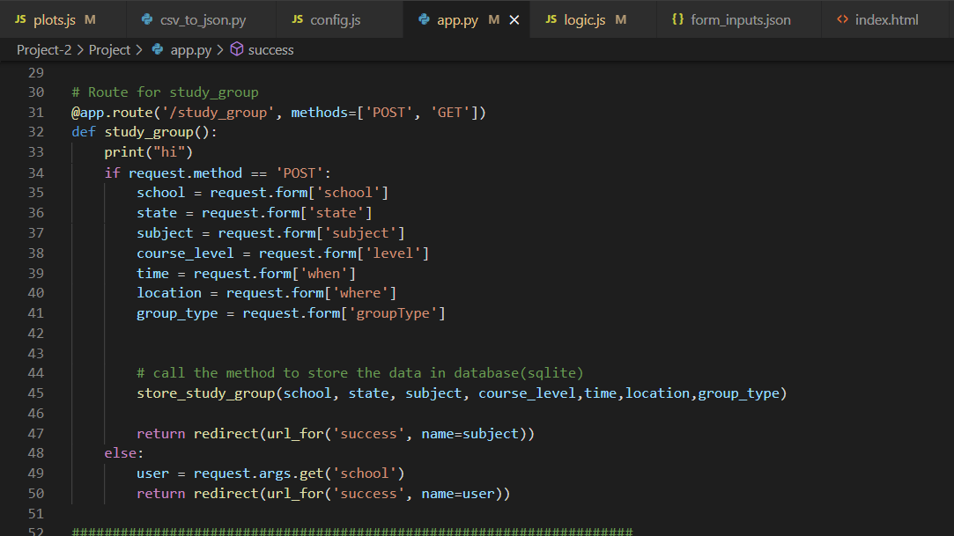
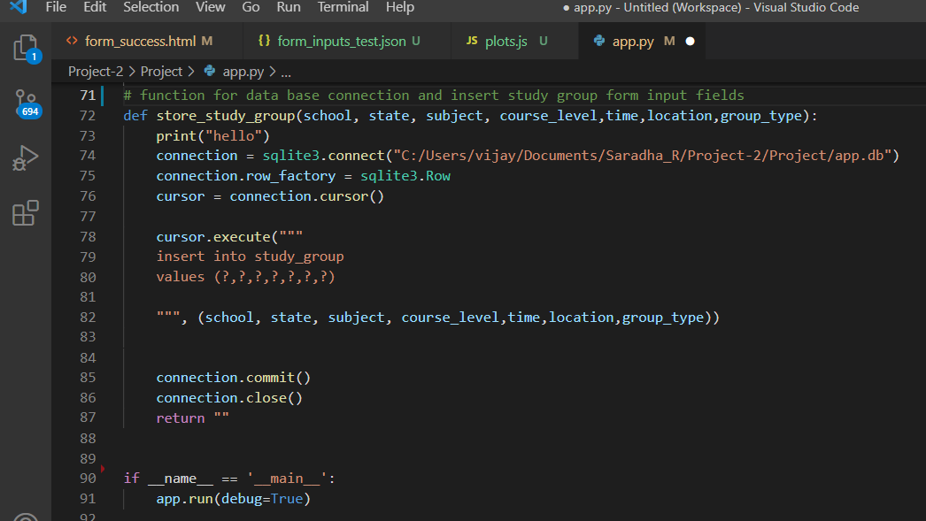
Python Flask API
s

Slide 5
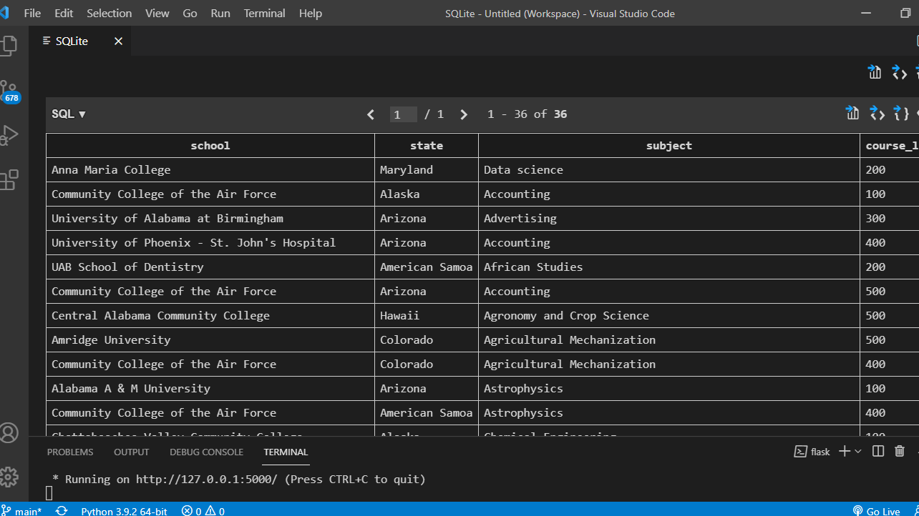
SQLite - Study group table
s

Slide 6
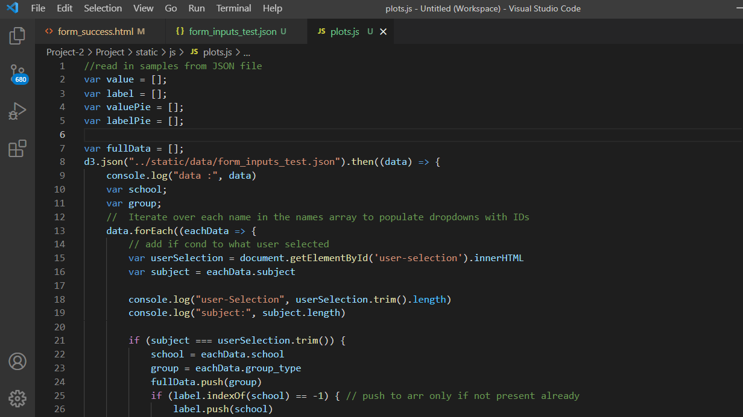
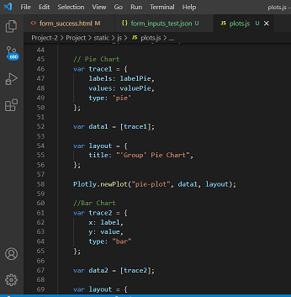
Plotly Chart
G

Slide 7
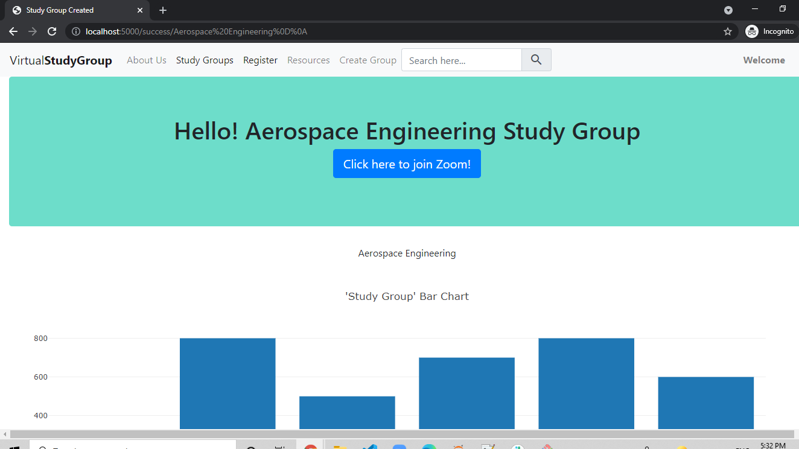
Study Group DashBoard
G

Slide 8
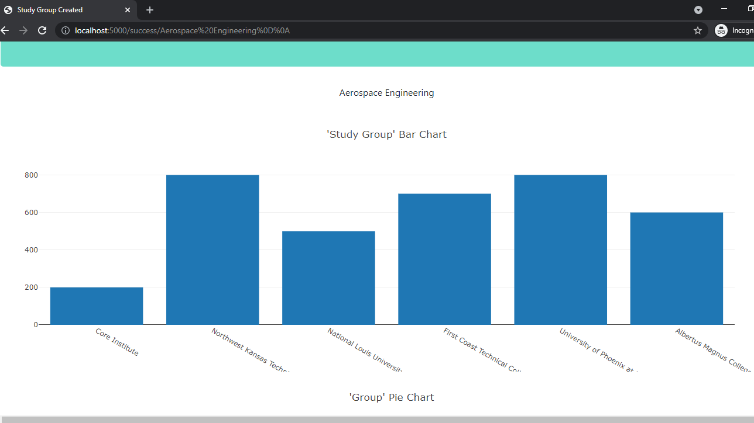
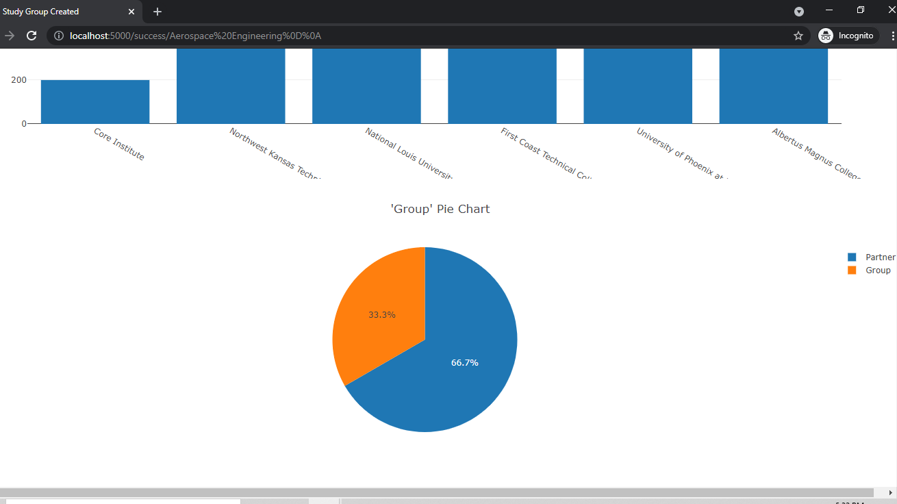
Study group Bar and Pie charts

Slide 9
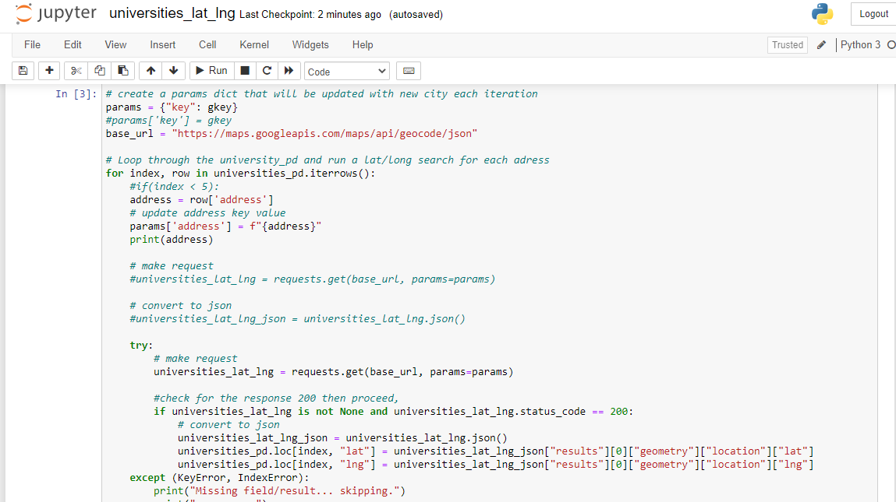
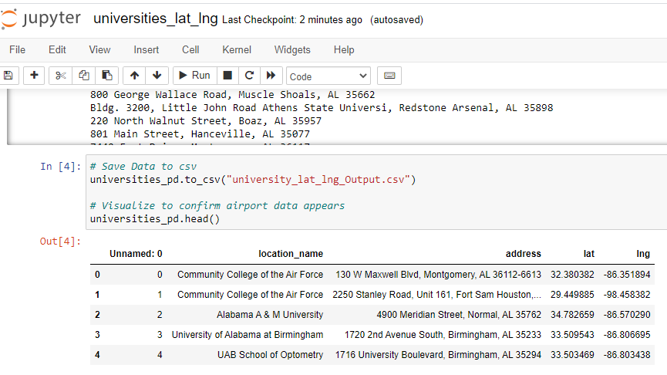
Google map API
c

Slide 10
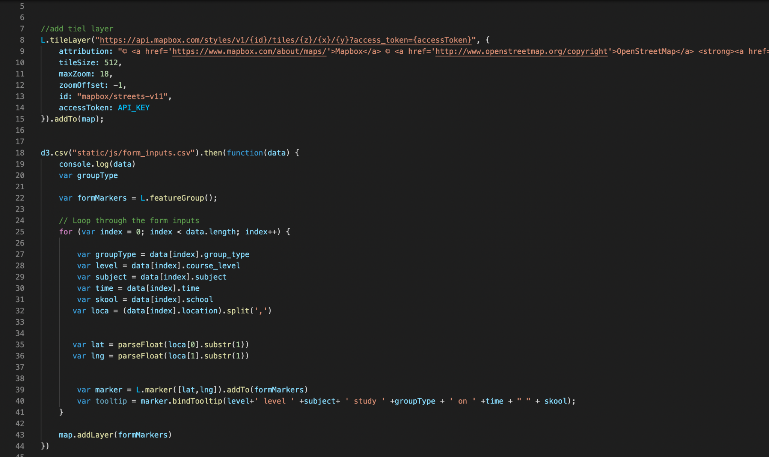
Study Group University Location Markers
c

Slide 11
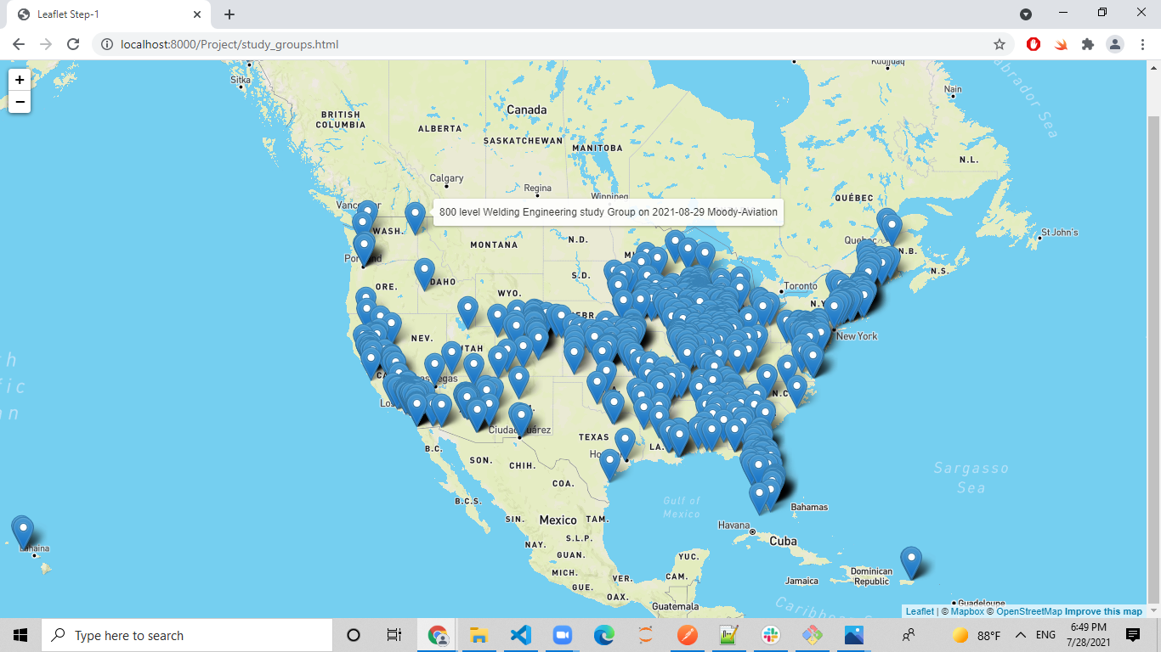
Leaflet - universities markers
c

Slide 12
Final Thoughts
-If we had had more time we would have added additional functionality to the website. eg Being able to search the study map for groups of a certain level or subject, and being able to generate links to webpages for the different groups to meet on
J

